Slide 1


Know Your Rights: REENTRY CLINIC
The Bronx Defenders with CLEARY GOTTLIEB

Slide 2
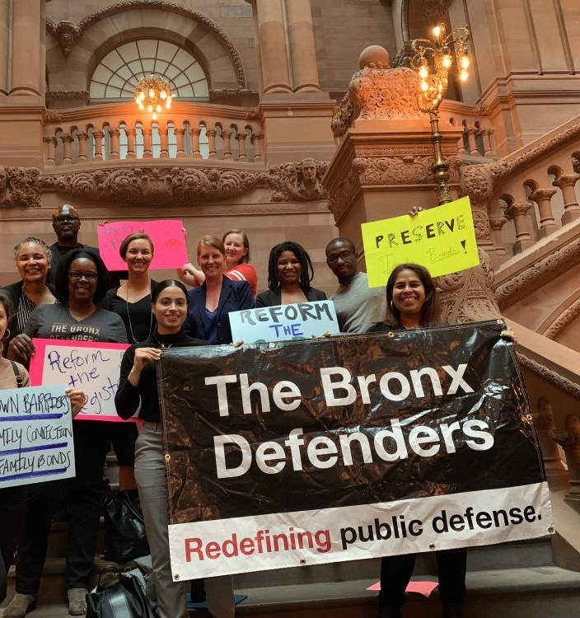
THE BRONX DEFENDERS: Who We are….
The Bronx Defenders provides innovative, holistic, and client-centered services, including:
Criminal defense,
Family defense,
Civil legal services,
Immigration representation,
Social work support, and
Advocacy
Our staff of over 300 represents 25,000 low-income residents of the Bronx each year and reaches many more through outreach programs and community legal education.

Slide 3

OUR STAFF
Our diverse staff includes criminal, civil, family, and immigration attorneys; social workers; benefits specialists; investigators; community organizers; team administrators; and civil legal, parent, policy, and immigration advocates.
The Bronx Defenders | 360 East 161st St. | Bronx, NY, 10451| Tel: 718.838.7878
For more info:
info@bronxdefenders.org
www.bronxdefenders.org
www.reentry.net

Slide 4
Know Your Rights: NYC FAIR CHANCE ACT
Overview of the Law: NYC Fair Chance Act
Protections during your job search
Protections during your employment
Exemptions under the law
Next Steps
Helpful Hints in the Job Search
How to Remove Barriers

Slide 5
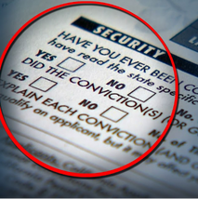

CRIMINAL RECORD? YOU CAN STILL WORK!!
In NYC, your criminal record shouldn’t be a barrier to your ability to earn a living, provide for your family, and contribute to your community.
NYC has strong protections against employment discrimination based on criminal history- NYC FAIR CHANCE ACT.
You are protected whether you are looking for a job or if you are already employed.
While most employers doing business in NYC have to follow these rules, there are some exemptions

Slide 6
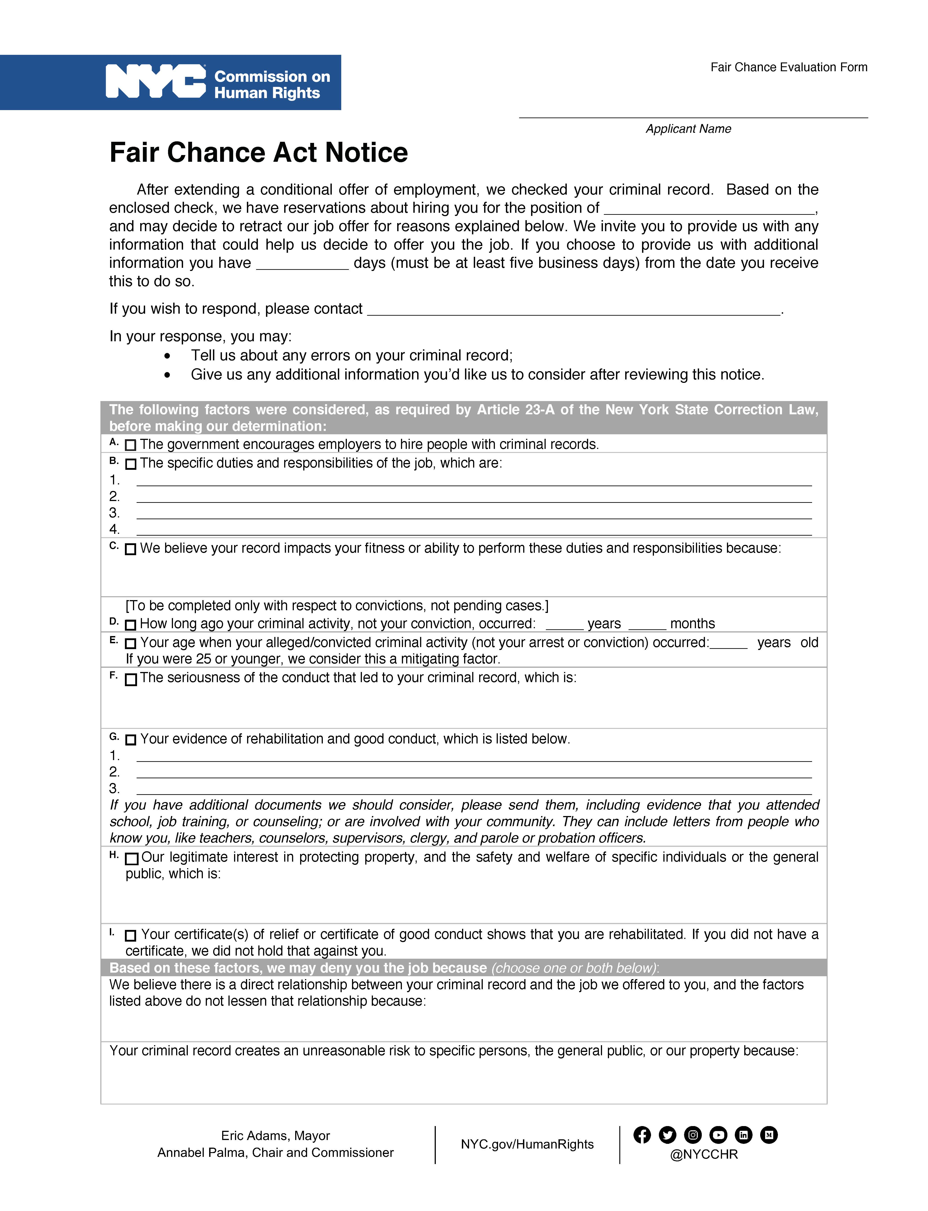
What is the Fair Chance Act?
The Fair Chance Act makes it illegal for most employers in New York City to ask about the criminal record of job applicants before making a job offer. This means ads, applications, and interview questions cannot include inquiries into an applicant's criminal record. This allows the applicant to be judged on his or her qualifications.
If, after a job offer, an employer wants to revoke the offer based on the existence of criminal record, the employer must explain why using the Fair Chance Notice , provide a copy of any background check conducted by the employer or third-party vendor, and give the applicant five business days to respond.

Slide 7
PROTECTIONS DURING YOUR JOB SEARCH
Job Postings and Applications
Employers and Temp agencies can’t mention anything about criminal history or background checks when they advertise jobs.
Examples of illegal activity by employers in job ads:
“Background Check Required”
“No Felonies”
Job Interviews
Employers can’t mention anything about criminal history or background checks in your interview.
They can’t ask you if you have a record or can pass a background check
Before they can ask about your criminal history, they must give you a conditional offer of employment

Slide 8
CONDITIONAL JOB OFFER
You have passed the interview stage and they want to give you the job.
Now the employer can ask you about your criminal record, but you are still protected from certain types of questions and the employer cannot just decide not to hire you because of what they find.
Employers may never ask about and ignore any information they learn about the following:
Non-convictions (includes arrests that are not prosecuted, acquittals, dismissed charges, expunged and vacated cases)
ACD (Adjournment in Contemplation of Dismissal)
Y.O. cases (Youthful Offender)
Violations
Non-criminal offenses (this does not include driving infractions)
Sealed cases
Employers are permitted to consider:
Open or pending cases
Misdemeanor convictions
Felony convictions
Driving infractions

Slide 9
Fair Chance Process
If an employer has no concerns after reviewing your record, the job is yours. If they do have concerns, the employer must ask you for evidence of good conduct or rehabilitation and do a “Fair Chance Analysis” of your record.
An employer may only take away your job offer for two reasons
There is a direct relationship between the alleged crime or conviction
Hiring you would involve an unreasonable risk to people or property
The Employer must consider these “Fair Chance Factors” to determine if there is a direct relationship or an unreasonable risk
NY encourages employment for people with criminal records
The specific job duties and responsibilities
Whether your record affects your ability to perform one or more job duties
The time since the alleged or convicted crime occurred (not the date of the arrest or conviction)
Your age when the alleged or convicted crime occurred (if you were 25 or younger, that’s a mitigating factor that weighs in your favor.)
The seriousness of your alleged or convicted conduct. (Possession or sale of a controlled substance is not considered particularly serious in this context).
Evidence of your accomplishments, such as rehabilitation or good conduct.
The employer’s interest in protecting people and property.
If you have a certificate of relief from disabilities or a certificate of good conduct, the employer must presume that you are rehabilitated.
The analysis must be written, and they must give you at least 5 days to respond with information

Slide 10
PROTECTIONS DURING EMPLOYMENT
You still are protected even when you have a job
Like the Fair Chance Analysis for job seekers, but it must also look at your job performance.
You can only be disciplined for your arrest/conviction, if they find a direct relationship or it causes an unreasonable risk
The employer may place you on leave for a reasonable time period (usually 5 business days) while they do an analysis.
You have at least 5 days to respond to their request for information and their request must be in writing.

Slide 11
EXEMPTIONS UNDER THE LAW
Police Officers, Peace Officers, and Civilian Law Enforcement
If you are working in a civilian position at a law enforcement agency, ACDs can’t be used against you
Certain Financial jobs
Criminal Background Checks Required by Law
Laws the Exclude Particular Convictions
May not ask about other convictions until a conditional offer is made
Certain City Government Jobs
Still Cannot mention background checks in job postings or ads

Slide 12
NEXT STEPS AND HELPFUL HINTS IN THE JOB SEARCH
You do not have to disclose your criminal record before a conditional offer of employment is made unless an exemption applies
Know your criminal record before you look for a job
Always respond to the Fair Chance Analysis.
These protections apply even if your arrest or conviction happened in another state
If you experience discrimination based on your criminal history, you can consult an attorney or legal aid provider like the Bronx Defenders.
Or you can file a complaint with the NYC Commission on Human Rights at 212-416-0197 or call 311 and say “human rights”.
NYC.gov/HumanRights

Slide 13
HOW TO REMOVE BARRIERS
Certificate of Relief From Disabilities (CRD)
You can get a CRD if you have been convicted of any number of misdemeanors or violations, but have not been convicted of more than 1 felony (2 or more felony convictions in the same court on the same day are counted as 1 felony for the CRD)
You need a separate CRD for each conviction
Easier to get at Sentencing than after!!
Certificate of Good Conduct
You are eligible to apply for a CGC if you have been convicted of 2 or more separate felonies, or if you want a job that is a Public Office (for public office jobs it doesn’t matter how many convictions you have, you need a CGC).
When counting felony convictions, federal and out-of-state charges count too.
SEALED RECORDS AFTER 10 YEARS CPL 160.59
No more than two misdemeanor convictions or 1 felony and 1 misdemeanor
You are eligible if you have been conviction free for at least 10 years since your last conviction and/or release.
Sex offenses, violent felonies, and serious felonies are not eligible for sealing.
Re-entry programs:
Osbourne Association: https://www.osborneny.org
Fortune Society: https://fortunesociety.org

Slide 14
CLEAN SLATE: What the Clean Slate Act does
This law will automatically seal certain criminal records after a required waiting period – three years after conviction or release from jail for a misdemeanor and eight years after conviction or release from prison for a felony – provided you have maintained a clean record and are no longer on probation or parole.
There are instances where people will not be eligible for sealing. Those with pending criminal charges, who are required to register as a sex offender, who received a life sentence, or who have been convicted of a class A felony – like murder – are ineligible to have their records sealed under Clean Slate.
Importantly, this law still provides access to otherwise sealed records for certain necessary and relevant purposes, including:
law enforcement purposes
licensing or employment for specific industries where a criminal background check is required to be performed
employment where a fingerprint-based background is performed
extending employment to a person in jobs where they may work with such groups as children, the elderly or other vulnerable populations
when an individual is seeking a gun license, a commercial driver’s license, or where required for public housing
To ensure adequate time for the necessary procedures to be put into place, the law will take effect one year after the governor signs it (November 2024) and the Office of Court Administration will have up to three years to seal conviction records that were eligible before the law went into effect.

